Slide 1
Lecture 11
Device Drivers

Slide 2
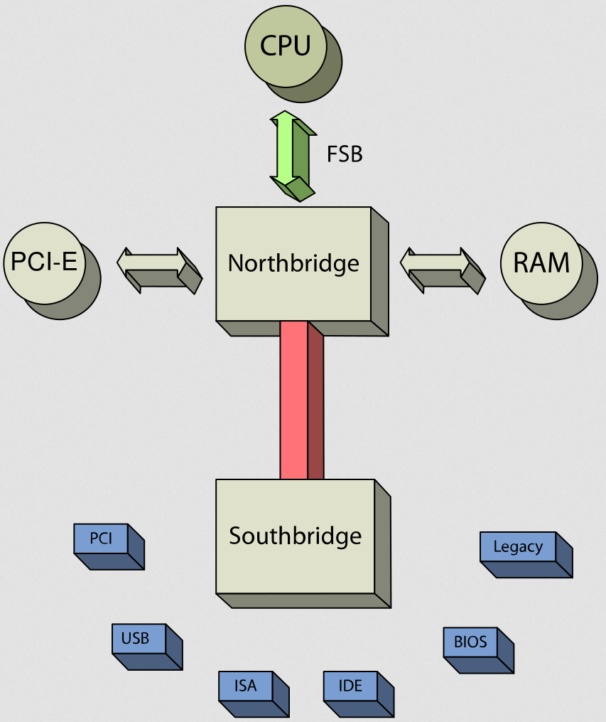
Input-Output
Any subsystem output of processor and memory is considered I/O
Flexible configuration by user
OS must handle and abstract diversity
A typical arrangement in a PC:

Slide 3
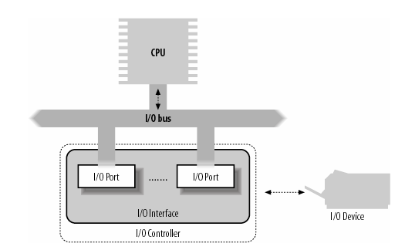
I/O Port I/O on x86
Intel x86 uses 16 bits to address I/O devices and 8, 16 or 32 bit for data
Each of the addressed location is called a “I/O port”
Four special x86 instructions perform I/O
in, ins, out, outs
Transfers data from a device to a register in the processor
Source: Bovet, Daniel P., Understanding the Linux Kernel.

Slide 4
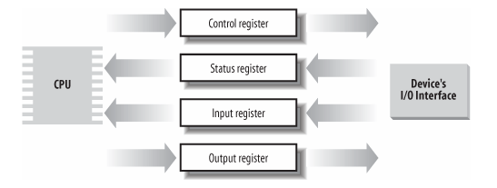
Generic I/O Device
Source: Bovet, Daniel P., Understanding the Linux Kernel.

Slide 5
Resource
How can one find which I/O port is for what?
Linux manage this in a tree-like structure rooted at ioport_resource
Use a tree to reflect hierarchy of the device connections
API’s for resource management:
request_resource()
allocate_resource()
release_resource()

Slide 6
I/O interface
An I/O interface is a hardware circuitry inserted between a group of I/O ports and their corresponding device controller
Translates the values in the I/ O ports into commands and data for the device
Detects changes in the device state and correspondingly updates the I/ O port
May involve a IRQ line to the PIC so as to issue hardware interrupts

Slide 7
Types of I/O interface
Custom interface – devoted to one specific hardware
Example: keyboard, graphics, disk, mouse, network
General purpose interface
Example: parallel port, serial port, PCMCIA, SCSI, USB

Slide 8
Device Controllers
Interprets the high-level commands received from the I/ O interface and forces the device to execute specific actions by sending proper sequences of electrical signals to it
Converts and properly interprets the electrical signals received from the device and modifies (through the I/ O interface) the value of the status register

Slide 9
Memory-mapped I/O
Instead of a distinct space, I/O is embedded inside the memory space
Uses loads and stores
Suitable for fast devices and DMA

Slide 10
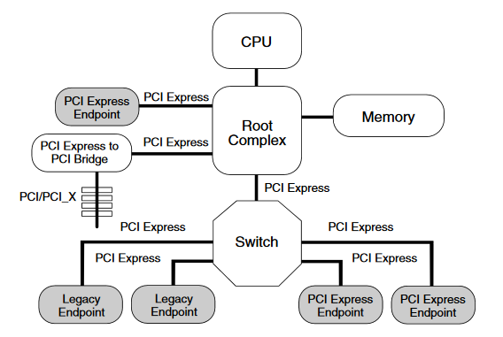
PCI Express
Goal: high performance I/O
Created in 2004 by a consortium
Introduces a lane
Up to 32 lanes (x1, x2, x4, x8, x12, x16, x32)
Each lane is full-duplex transport for a byte
Complex communication protocol resembling a network protocol

Slide 11
Device Drivers

Slide 12
Device Drivers
Device drivers
Black boxes to hide details of hardware devices
Use standardized calls
Independent of the specific driver
Main role
Map standard calls to device-specific operations
Can be developed separately from the rest of the kernel
Plugged in at runtime when needed

Slide 13
The Role of the Device Driver
Implements the mechanisms to access the hardware
E.g., show a disk as an array of data blocks
Does not force particular policies on the user
Examples
Who many access the drive
Whether the drive is accessed via a file system
Whether users may mount file systems on the drive

Slide 14
Policy-Free Drivers
A common practice
Support for synchronous/asynchronous operation
Be opened multiple times
Exploit the full capabilities of the hardware
Easier user model
Easier to write and maintain
To assist users with policies, release device drivers with user programs

Slide 15
Splitting the Kernel
Process management
Creates, destroys processes
Supports communication among processes
Signals, pipes, etc.
Schedules how processes share the CPU
Memory management
Virtual addressing

Slide 16
Splitting the Kernel
File systems
Everything in UNIX can be treated as a file
Linux supports multiple file systems
Device control
Every system operation maps to a physical device
Few exceptions: CPU, memory, etc.
Networking
Handles packets
Handles routing and network address resolution issues

Slide 17
Splitting the Kernel
Source: Bovet, Daniel P., Understanding the Linux Kernel.

Slide 18
Loadable Modules
The ability to add and remove kernel features at runtime
Each unit of extension is called a module
Use insmod program to add a kernel module
Use rmmod program to remove a kernel module

Slide 19
Classes of Devices and Modules
Character devices
Block devices
Network devices
Others

Slide 20
Character Devices
Abstraction: a stream of bytes
Examples
Text console (/dev/console)
Serial ports (/dev/ttyS0)
Usually supports open, close, read, write
Accessed sequentially (in most cases)
Might not support file seeks
Exception: frame grabbers
Can access acquired image using mmap or lseek

Slide 21
Block Devices
Abstraction: array of storage blocks
However, applications can access a block device in bytes
Block and char devices differ only at the kernel level
A block device can host a file system

Slide 22
Network Devices
Abstraction: data packets
Send and receive packets
Do not know about individual connections
Have unique names (e.g., eth0)
Not in the file system
Support protocols and streams related to packet transmission (i.e., no read and write)

Slide 23
Other Classes of Devices
Examples that do not fit to previous categories:
USB
SCSI
FireWire
MTD

Slide 24
File System Modules
Software drivers, not device drivers
Serve as a layer between user API and block devices
Intended to be device-independent

Slide 25
Security Issues
Deliberate vs. incidental damage
Kernel modules present possibilities for both
System does only rudimentary checks at module load time
Relies on limiting privilege to load modules
And trusts the driver writers
Driver writer must be on guard for security problems

Slide 26
Security Issues
Do not define security policies
Provide mechanisms to enforce policies
Be aware of operations that affect global resources
Setting up an interrupt line
Could damage hardware
Setting up a default block size
Could affect other users

Slide 27
Security Issues
Beware of bugs
Buffer overrun
Overwriting unrelated data
Treat input/parameters with utmost suspicion
Uninitialized memory
Kernel memory should be zeroed before being made available to a user
Otherwise, information leakage could result
Passwords

Slide 28
Security Issues
Avoid running kernels compiled by an untrusted friend
Modified kernel could allow anyone to load a module

Slide 29
Version Numbering
Every software package used in Linux has a release number
You need a particular version of one package to run a particular version of another package
Prepackaged distribution contains matching versions of various packages

Slide 30
Version Numbering
Different throughout the years
After version 1.0 but before 3.0
<major>.<minor>.<release>.<bugfix>
Time based releases (after two to three months)
3.x
Moved to 3.0 to commemorate 20th anniversary of Linux
<version>.<release>.<bugfix>
https://lkml.org/lkml/2011/5/29/204

Slide 31
sysfs

Slide 32
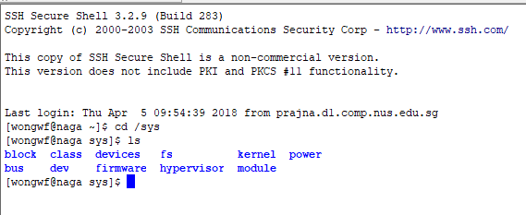
The Linux Driver Model
The big idea: everything is a file
Leverage on VFS
Exception: network cards
Expose the hierarchical relationships between devices
The components of sysfs
block – block devices
devices – all hardware devices recognized by the kernel
bus – buses
drivers – the device drivers
class – the main category of devices
power – for power management
firmware – handle firmware

Slide 33
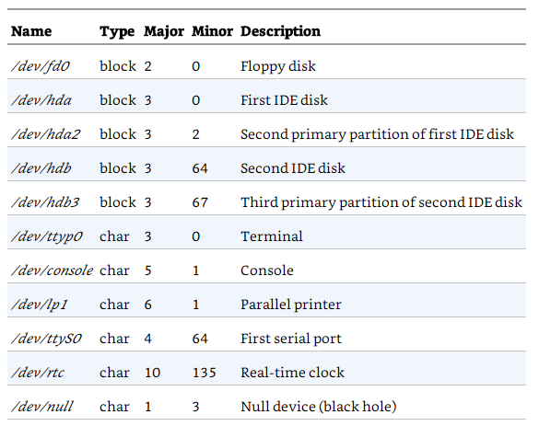
Examples

Slide 34
Character vs block devices
The data of a block device can be addressed randomly, and the time needed to transfer a data block is small and roughly the same
Examples: hard disks, floppy disks , CD-ROM drives, and DVD players
The data of a character device either
cannot be addressed randomly,
or they can be addressed randomly, but the time required to access a random datum largely depends on its position inside the device

Slide 35
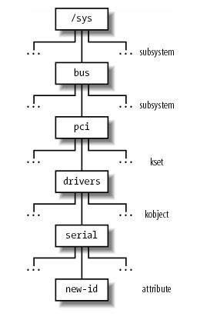
Kobjects
Core data structure for device drivers
Each kobject corresponds to a directory in sysfs
Embedded inside containers
Descriptors for buses, devices, and drivers
Kobjects are grouped into ksets of the same type (container)
Ksets may form subsystems (hierarchy)
All the above must be registered with the kernel
Source: Bovet, Daniel P., Understanding the Linux Kernel.

Slide 36
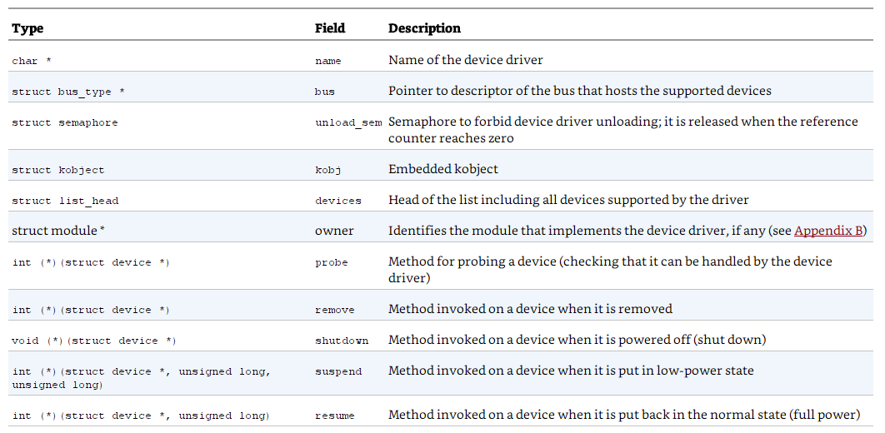
Components of the Linux device model (1)
Each device has a device object
Associates with a kobject
Each driver has a device_driver object
Fields in
device_driver

Slide 37
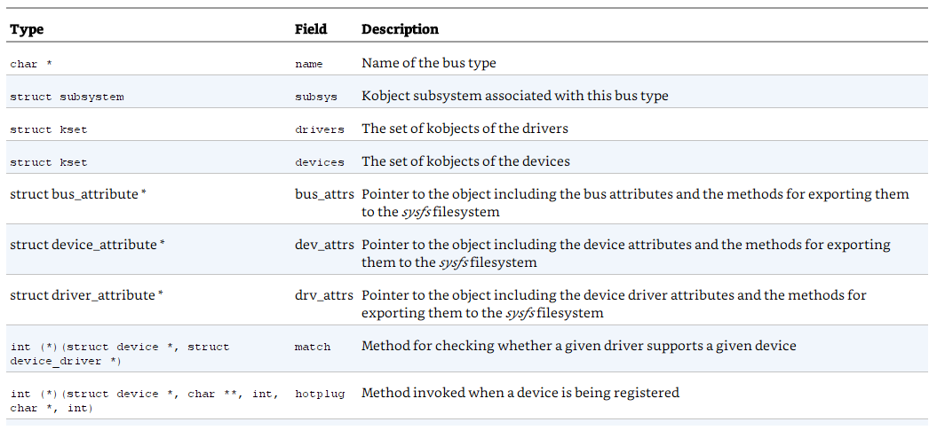
Components of the Linux device model (2)
Buses are represented by bus_type objects
Fields in
bus_type

Slide 38
Components of the Linux device model (3)
Each class of devices has a class object
All class objects belong to the class_subsys subsystem associated with /sys/class
One class_device descriptor for each logical device of the class
A device can belong to multiple class_device
Example: a sound card is a hardware device that usually includes a DSP, a mixer, a game port interface, and so on.
Device drivers in the same class are expected to offer the same functionalities to the user mode applications

Slide 39
Device number
Linux maintains an official list of allocated device numbers
Documentation/devices.txt
Major number
12 bits
Minor number
20 bits
Each logical device in the system should have an associated device file with a well-defined device number
When a device driver registers, it will specify (static) or request to be allocated (dynamic) a range of device numbers that it will handle

Slide 40
Dynamic device file creation
Simply too many possible devices
From kernel 2.6 – create on demand dynamically
Uses the udev toolset
Supports device hotplugging

Slide 41
The role of VFS
Device files exist in the system directory but are intrinsically different from ordinary files
VFS hides the difference
VFS changes the default file operations of a device file when it is opened to do the appropriate device operations

Slide 42
Monitoring I/O
Duration of I/O is unpredictable
Question: how do we know an I/O request is terminated or completed?
Two modes:
Polling
for (;;) {
if (read_status( device) & DEVICE_END_OPERATION) break;
if (--count = = 0) break;
}
Interrupt
Lower overhead
Can only be done if device has hardware for doing a IRQ

Slide 43
Character Device Drivers

Slide 44
Character devices
Usually simpler hardware
No caching
No re-reads of same bytes
No sophisticated communication protocol involved

Slide 45
Character device drivers
Kernel maintains a hash table chrdevs containing intervals of device numbers with handlers
On initialization, a character device driver much specify what range of device numbers it will handle, or ask for that range to be dynamically allocated
Character devices can transfer large number of bytes in a single I/O
Use buffering
Good news: same buffer never refused – makes for easier management

Slide 46
Block Device Drivers

Slide 47
Block devices
Usually more complex hardware
Access is slow
Situation is changing
Applications can repeatedly read or write the same block of data
Example: disks

Slide 48
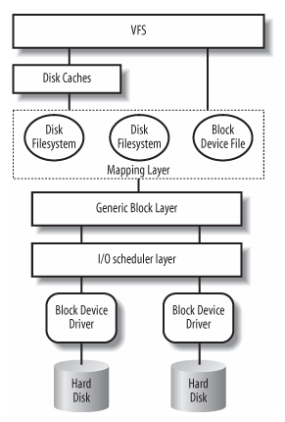
Block I/O
VFS needs to check if block is already in some kind of caches
If yes, serves request from memory cache
If no, determine physical location of block via mapping layer
From block size, compute file block numbers
From file’s inode data determine position on disk in terms of logical block number
Issues operations to a generic block layer which issues block I/O requests
I/O scheduler layer implements I/O policies
Finally, block device drivers perform actual operation on device
Source: Bovet, Daniel P., Understanding the Linux Kernel.

Slide 49
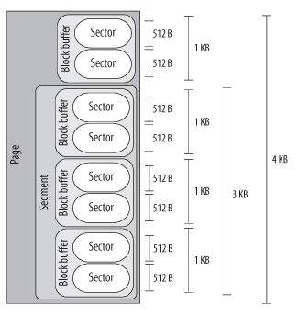
Size matters
Source: Bovet, Daniel P., Understanding the Linux Kernel.
Hardware transfers data in sectors
VFS uses logical units called blocks
Block device drivers can work with adjacent data in segments
Disk caches work with pages
Typical sizes

Slide 50
The Generic Block Layer
Put data into buffers
“Zero copy” – directly put data into user space
Manage logical volumes
LVM, RAID
Exploit advance features in modern disk controllers
The bio structure contains all information regarding an ongoing block I/O operation

Slide 51
Multi-Queue Block IO Queueing (blk-mq)
Slow devices like hard disk
A single queue to store block IO requests with a single lock
SSD, NVMe, supports parallelism well
Need for multiple queues with reduced synchronization overhead

Slide 52
Two types of queues in blk-mq
Hardware dispatch queues
A struct (struct blk_mq_hw_ctx) used by device drivers to map the device submission queues (or device DMA ring buffer)
The last step of the block layer submission code before the low level device driver takes over
Software staging queues
If there is an IO scheduler attached or
If we want to try to merge requests
Example: requests for sector 3-6, 6-7, 7-9 can become one request for sectors 3-9
(if no I/O scheduler)
User request hardware queue
software queue temporary queue
(if h/w queue full)

Slide 53
The I/O Scheduler
Generic block layer fires off random block I/O operations. But random access is bad for performance
I/O Scheduler tries to group I/O operations for best performance
However, deferring some I/O operations can lead to complications
Throw in the fact that block I/O are asynchronous and interrupt driven and you see the complications that the I/O scheduler has to deal with
In implementing any scheduling policies, I/O scheduler must ensure deadlocks etc. won’t arise
Also, tries to implement fairness of resource usage
$ cat /sys/block/<device>/queue/scheduler

Slide 54
How I/O scheduling works
Generic block layer invokes I/O scheduler to determine where a new request should be added to a request queue
I/O scheduler tries to keep request queue sorted by sector
Reduces disk seeking
Resembles elevator scheduling: hence the I/O schedulers are known as elevators
After computing priorities, I/O scheduler will finally insert into a dispatch queue – the actual ordering of requests that a device driver should process

Slide 55
The I/O Scheduler Algorithms (Basic)
NOOP elevator: simplest, no sorting, either FIFO or LIFO
Complete Fairness Queuing (CFQ) elevator: maintains a large number of queues (default 64)
Processes are hashed to queues by process IDs
Each queue is sorted by sectors
Deprecated

Slide 56
Budget Fair Queueing I/O Scheduler (BFQ)
Built from CFQ elevator code
Guarantees a high system and application responsiveness, and a low latency for time-sensitive applications, such as audio or video players
Prioritizes latency over throughput
Distributes bandwidth, and not just time, among processes or groups
Switch back to time distribution when needed to keep throughput high

Slide 57
How BFQ works (1)
Each process doing I/O on a device has a weight and a queue
Every queue has a budget, measured in number of sectors
A queue (process) is given exclusive access to a device, and issues requests to the device until
The queue becomes empty
Not immediately, will wait a while to give the process chance to issue more requests
The budget is exhausted
A timeout (to take care of random access)
If queue is marked “low latency”, special heuristics are used instead to ensure low latency

Slide 58
How BFQ works (2)
Early Queue Merge (EQM): used to merge requests to a device
A request targeting a device is checked with the next in line on the current active queue of the device (which may belong to another process). If hit, merge!
Queues are scheduled (selected) based on Worst-case Weighted fair Queueing (WF2Q+)
Completely Fair Scheduler also based on similar idea
Also uses a red-black tree

Slide 59
Multiqueue Deadline Elevator (mq-deadline)
4 queues (1 read sorted by sector, 1 write sorted by sector, 1 read sorted by deadline, 1 write sorted by deadline)
A read (write) request will enter BOTH the read-by-sector (write-by-sector) and read-by-deadline (write-by-deadline)
A read request expires in 500 ms after entry into queue; 5 sec for write
First (using heuristic) determine whether to do read or write for the next batch of entries in the dispatch queue
Reads preferred, unless writes skipped over for too long
If, say, read is chosen, check read deadline queue. If head of that queue has expired, dispatch that. Then try to choose requests adjacent to this from the sector queue.
If no expired request, dispatch from where last left out in sector queue
Reset to head when end of queue is reached

Slide 60
Kyber I/O Scheduler
Designed for fast storage like SSD, NVMe
Self-tuning
Key to speed is to keep overheads low, operations simple
Two primary queues, one for synchronous requests (reads) and one for asynchronous requests (writes)

Slide 61
How Kyber works
Controls the number of entries of each type in a hardware queue
Using tokens
Aim: keep the queue short for better response time
Simple merging attempted
Tunes the actual number of requests allowed (#tokens) into the dispatch queues by measuring the completion time of each request and adjusting the limits to achieve the desired latencies

Slide 62
END

